Slide 1
Recurrent Neural Networks

Slide 2
How do we model such tasks involving sequences?

Slide 3


Slide 4
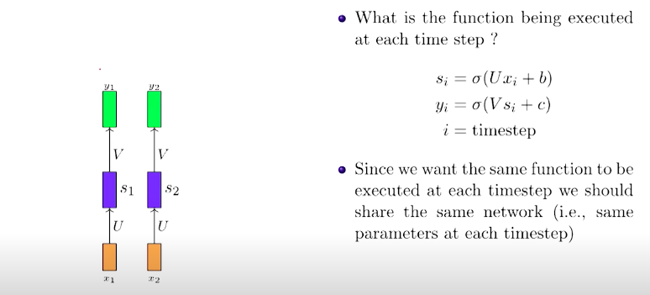

Slide 5
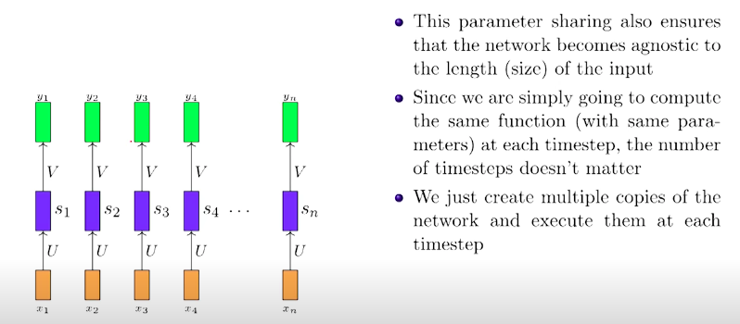

Slide 6
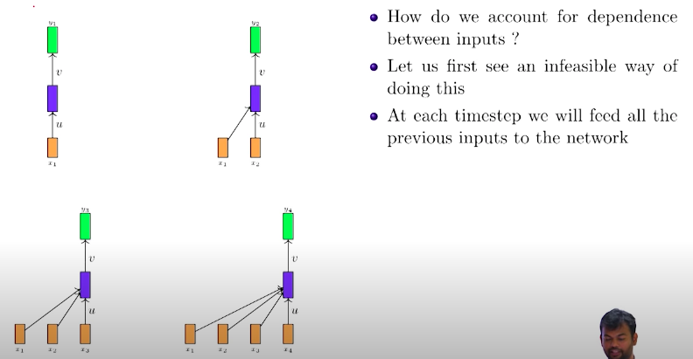

Slide 7
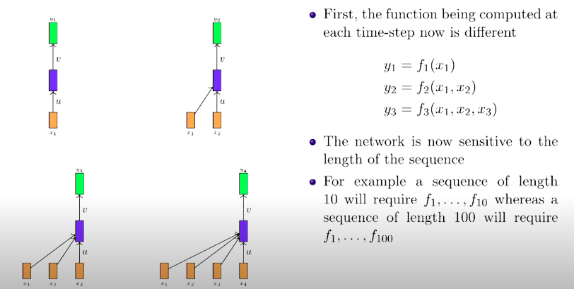

Slide 8
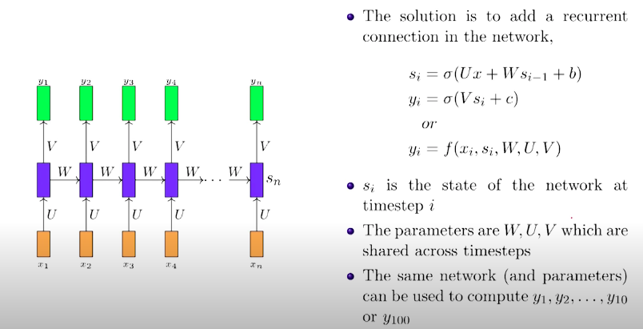

Slide 9
